Slide 1
Microservices
Overview

Slide 2
Table of Contents
Introduction
- How would each Dev Team use APIs? Why is this important to them
Why would you use microservices?
What is your readiness?
Do you have upcoming projects that would benefit?
Which teams outside of yours would need to assist?
Microservices Explained
Principles of Microservices
Principle 1 – Modelled around business domain
Principle 2 – Culture of Automation
Principle 3 – Hide Implementation Details
Principle 4 – Decentralize all the things
Principle 5 – Deploy independently
Principle 6 – Consumer First
Principle 7 – Isolate Failure
Principle 8 – Highly Observable
Microservices Platforms
Containers
Container Orchestration and Management
API Gateway
Security
DevOps
Continuous Integration and Automated Deployments
Migrating to Microservices
Strategies and Recommendations
Where to Start
Design Patterns
Closing
Summary

Slide 3
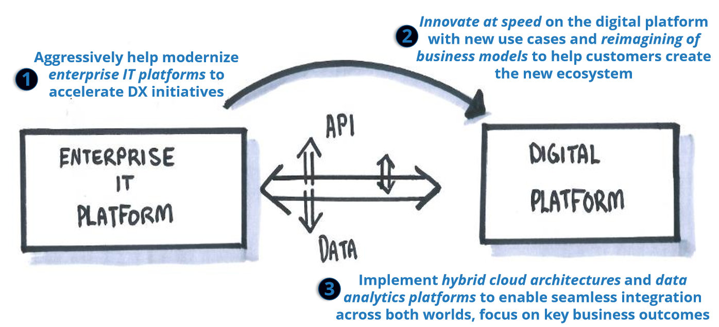
Develop the Digital Platform of the Future
Introduction
Data friction and the inability for systems and people to easily and securely access information will hinder our digital transformation

Slide 4
Today’s Challenges
Introduction
Email
Budgets
75%
Global IT budgets dedicated to maintenance
EDW
Orders
Cost
Mash-up App
28%
Time spent on administrative tasks
CRM
Employee
Invoices
Agility
Financials
Approvals
40%
Increase of data breach incidents in 2016
ECM
Expenses
Security

Slide 5
Why now is the time
Introduction
Cost
Agility
Security
Reduce costs by up to 90% by digitizing businesses processes
Agile firms grow revenue up to 37% faster
94% on-premises customers experienced additional security benefits

Slide 6
What is a microservice
Introduction
First and foremost, Microservices is an architectural style for building distributed systems.
Microservice applications are composed of small, independently versioned, and scalable customer-focused services that communicate with each other over standard protocols with well-defined interfaces.
Encapsulate a customer or business scenario.
Developed by a small engineering team.
Written in any programming language and use any framework.
Consist of code and (optionally) state, both of which are independently versioned, deployed, and scaled.
Interact with other microservices over well-defined interfaces and protocols.
Have unique names (URLs) used to resolve their location.
Remain consistent and available in the presence of failures.
Microservices are small, autonomous services that work together.

Slide 7
So, what are microservices really and how does this architecture improve delivery cycles?
Introduction
The idea behind microservices is that some types of applications become easier to build and maintain when they are broken down into smaller, composable pieces which work together.
Each component is developed separately, and the application is then simply the sum of its constituent components. This is in contrast to a traditional, "monolithic" application which is all developed all in one piece.
There are many reasons why this approach is considered an easier way to develop large applications and various types of software as a service delivered over the Internet.
When the different components of an application are separated, they can be developed concurrently.
Another is resilience. Rather than relying upon a single virtual or physical machine, components can be spread around multiple severs or even multiple data centers. If a component dies, you spin up another, and the rest of the application can continue to function.
It allows more efficient scaling, as rather than scaling up with bigger and more powerful machines, or just more copies of the entire application, you can scale out with duplicate copies of the heaviest-used parts.

Slide 8
Benefits of Microservices to the Business
Introduction
Agility easier to respond to new customer and market needs
Allows for more frequent delivery and faster delivery times which quicker feedback cycles and pivoting
Better user experience
Response times enabled by scaling microservices independently
Availability enabled by resiliency
Enables new business models – API economy

Slide 9
Is this a new concept?
Introduction
The idea of separating applications into smaller parts is nothing new; there are other programming paradigms which address this same concept, such as Service Oriented Architecture (SOA).
What may be new are some are the tools and techniques used to deliver on the promise of microservices.
There is a culture shift required for an organization to have the know-how, and structures in place for development teams to be able to adopt this model.
Part of a larger shift towards a DevOps culture
Notes:
Introducing the principles of microservices
Principle 1 – Modelled around business domain
Principle 2 – Culture of Automation
Principle 3 – Hide Implementation Details
Principle 4 – Decentralize all the things
Principle 5 – Deploy independently
Principle 6 – Consumer First
Principle 7 – Isolate Failure
Principle 8 – Highly Observable

Slide 10
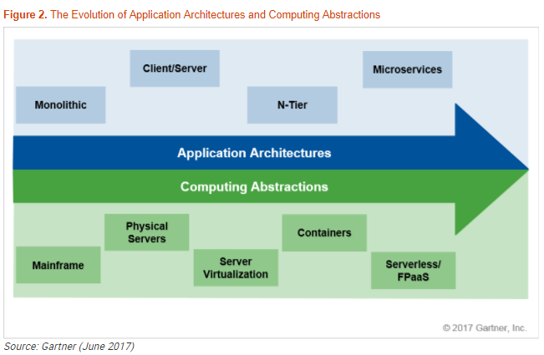
Evolution of Application Architectures & Computing Abstractions
Introduction
Gartner, Evolution of Server Computing: VMs to Containers to Serverless — Which to Use When? Arun Chandrasekaran, 26 June 2017

Slide 11
From Monoliths to Microservices – A Shift to a DevOps Culture
Microservices Explained
During the client-server era, we tended to focus on building tiered applications by using specific technologies in each tier.
The term monolithic application has emerged for these approaches.
The interfaces tended to be between the tiers, and a more tightly coupled design was used between components within each tier.

Slide 12


Microservices Explained
Traditional application approach
Microservices application approach
A traditional application has most of its functionality within a few processes that are componentized with layers and libraries.
Scales by cloning the app on multiple servers/VMs
App 1
A microservice application segregates functionality into separate smaller services.
Scales out by deploying each service independently with multiple instances across servers/VMs
App 1
App 2
Independent deployment of microservice
Coarse-grained density of apps/services
Fine-grained density of services
Need to deploy the full application
Notes:
During the client-server era, we tended to focus on building tiered applications by using specific technologies in each tier. The term monolithic application has emerged for these approaches
The interfaces tended to be between the tiers, and a more tightly coupled design was used between components within each tier.
Developers designed and factored classes that were compiled into libraries and linked together into a few executables and DLLs.
A monolithic app contains domain-specific functionality and is normally divided by functional layers, such as web, business, and data.
You scale a monolithic app by cloning it on multiple servers/virtual machines/containers.
This solution has a number of benefits:
Simple to develop
Simple to deploy
Simple to scale
And it has a number of problems:
Limited re-use is realized across applications.
Scaling monolithic applications can be a challenge.
Difficult to achieve operational agility in the repeated deployment of monolithic application artifacts.
Typically implemented using a single development stack (ie, JEE or .NET), which can limit the availability of “the right tool for the job.”
The microservice approach is to compose your application of many small services. The services run in containers that are deployed across a cluster of machines. Smaller teams develop a service that focuses on a scenario and independently test, version, deploy, and scale each service so that the entire application can evolve.
A microservice application separates functionality into separate smaller services.
The microservices approach scales out by deploying each service independently, creating instances of these services across servers/virtual machines/containers.
Benefits
Each Microservice encapsulates simpler business functionality, which you scale up or down, test, deploy, and manage independently
Smaller teams can develop a micro-service based on a customer scenario and use any technologies they choose.
Downsides
Managing increased number of separate entities and dealing with more complex deployments and versioning.
Network traffic between the microservices increases as well as the corresponding network latencies.

Slide 13
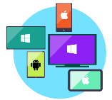



Microservices Explained
Data in Traditional approach
Data in Microservices approach
Single monolithic database
Tiers of specific technologies
Graph of interconnected microservices
State typically scoped to the microservice
Remote Storage for cold data
Web Tier
Services Tier
Cache doesn’t help much for massive data ingress (Events, IoT, etc.)
Mobile
apps
Web presentation services
Cache Tier
Database servers are usually the bottleneck
Stateless services
SQL DB
or
No-SQL
Stateful services
Data Tier
SQL
[…]
Monolithic Databases are shared across services.
Stateless services
with
separate stores
Each microservice owns its model/data!

Slide 14
Monolithic vs Microservices Architecture
Microservices Explained
 | Monolithic | Microservice
Architecture | Represents a single logical program unit. All functions, libraries and dependencies are located within one application block | Consists of a series of small services that work independently and communicate with each other. Each service can be used in more than one application.
Scalability | The entire application scales horizontally behind a load balancer | Each service scales independently and on demand
Agility | Changes to the system lead to the compilation, testing and deployment of the entire application | Each service can be changed independently
Development | Development based on a single programming language | Each service can be developed in a different programming language. Integration via a defined API.
Maintenance | Very long and confusing source code | Many pieces of source code that are easy to administrate

Slide 15
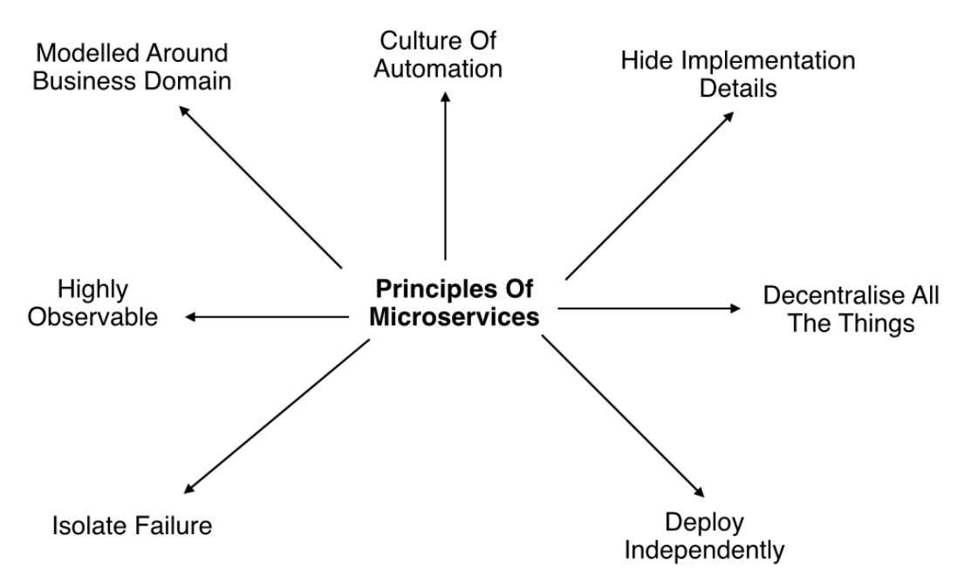
Principles of Microservices
Principles

Slide 16
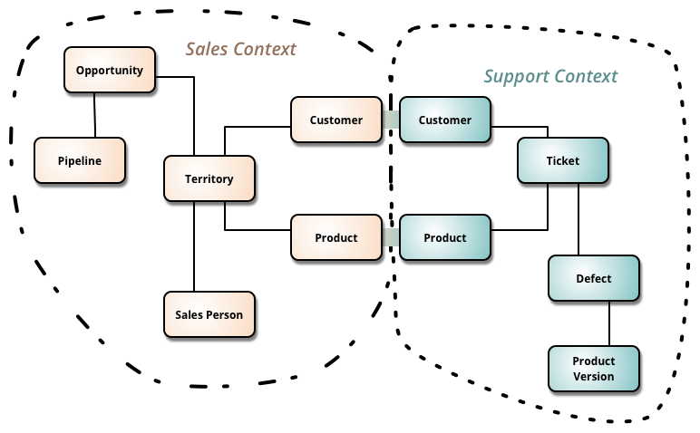
Principle 1 - Modelled around business domain
Principles
Microservices provide the ability to separate system capability into different domains using Domain Driven Design principles. The primary objective of the domain driven design is to focus on the core domain and the associated logic. This minimizes possibilities of the application getting out of hand. It also nurtures creative collaboration between the DevOps and development teams as both should understand the domain for scaling up.
Notes:
ffff

Slide 17
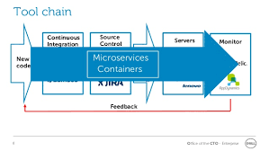
Principle 2 - Culture of Automation
Principles
The whole idea of microservices is to have a fairly large amount of small services and to be able to manage changes to these you need to have automated processes. This means that you will want to have:
infrastructure automation (provisioning of host environments)
automated testing
continuous delivery
Notes:
Automation is done in a form of tools since micro-services have many “moving parts”; therefore, testing can become complex. So, we create automated tools for testing. For example, the purpose of automating testing is to reduce the amount of time:
Required for manual regression testing.
For test integration between services and clients.
To set up test environments.
These automated testing tools should provide us with a quick feedback, confirm that changes integrates with the entire system, to test integrations (also known as continuous integrations), to help with the pipeline to deployment, to indicate our microservice deployment status (is it ready?), to check in a microservice, to provide a way a way to move the build to the target machine (or the target cloud system), and any other functionality that may help.
The concept of using tools for deployments belongs to the continuous deployment category. The use of continuous integration tools allows the microservice architecture, which is a complex distributed system with multiple instances of the services, to be organized.Since manual deployment would be too time consuming and unreliable.

Slide 18
Principle 3 - Hide Implementation Details
Principles
Microservices are small services with independent lifecycles that work together as a part of the whole application. However, each service can be independent when it has to be a part of the big structure. To enhance the ability of one service to scale independently of the others, it is important to hide each service implementation details. We could use REST protocol over HTTP and ensure services communicate with each other using a light-weight communication. Through this segregation of internal and external implementation, details can be achieved.
Notes:
Introducing the principles of microservices
Principle 1 – Modelled around business domain
Principle 2 – Culture of Automation
Principle 3 – Hide Implementation Details
Principle 4 – Decentralize all the things
Principle 5 – Deploy independently
Principle 6 – Consumer First
Principle 7 – Isolate Failure
Principle 8 – Highly Observable

Slide 19
Principle 4 - Decentralize all the things
Principles
Monolithic implementations usually have a single logical database for persistent data across a range of applications. It becomes complex to changes over a period of time. With microservices, each service can manage its own database, either different instances of the same database technology, or entirely different database systems.
Notes:
Introducing the principles of microservices
Principle 1 – Modelled around business domain
Principle 2 – Culture of Automation
Principle 3 – Hide Implementation Details
Principle 4 – Decentralize all the things
Principle 5 – Deploy independently
Principle 6 – Consumer First
Principle 7 – Isolate Failure
Principle 8 – Highly Observable

Slide 20
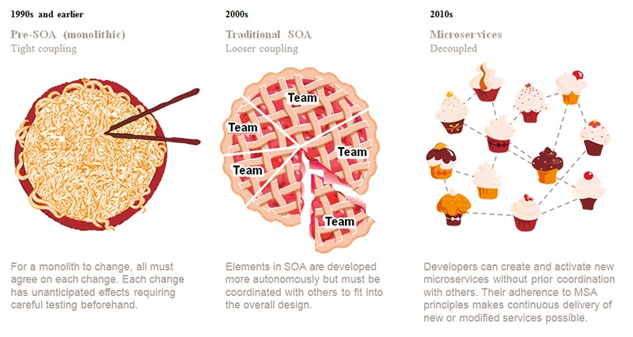
Principle 5 - Deploy independently
Principles
One service should be possible to deploy without taking any consideration to other services. If you need to co-ordinate release of one service with other services you need to get that resolved before introducing new service.
Notes:
Introducing the principles of microservices
Principle 1 – Modelled around business domain
Principle 2 – Culture of Automation
Principle 3 – Hide Implementation Details
Principle 4 – Decentralize all the things
Principle 5 – Deploy independently
Principle 6 – Consumer First
Principle 7 – Isolate Failure
Principle 8 – Highly Observable

Slide 21
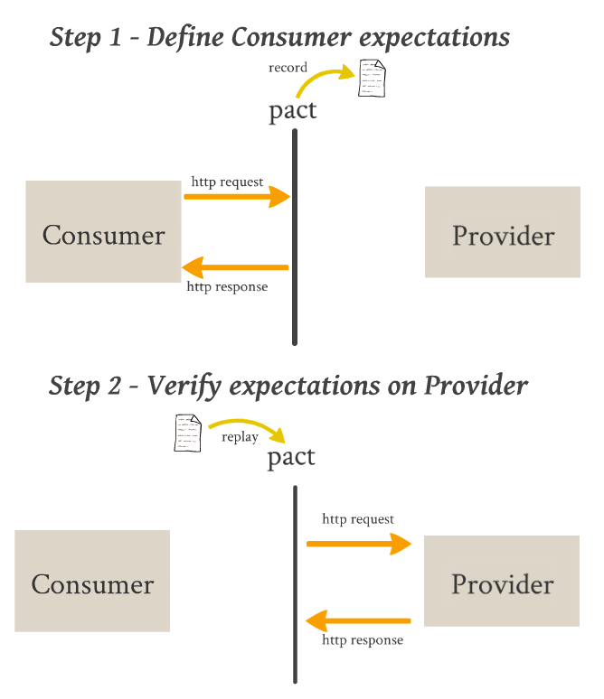
Principle 6 – Consumer First
Principles
Consumer contracts are not a new concept. In any case, they get more important again regarding microservice architectures. A consumer contract defines the expected structure of a response from the point of view of a service caller.
Notes:
Introducing the principles of microservices
Principle 1 – Modelled around business domain
Principle 2 – Culture of Automation
Principle 3 – Hide Implementation Details
Principle 4 – Decentralize all the things
Principle 5 – Deploy independently
Principle 6 – Consumer First
Principle 7 – Isolate Failure
Principle 8 – Highly Observable

Slide 22
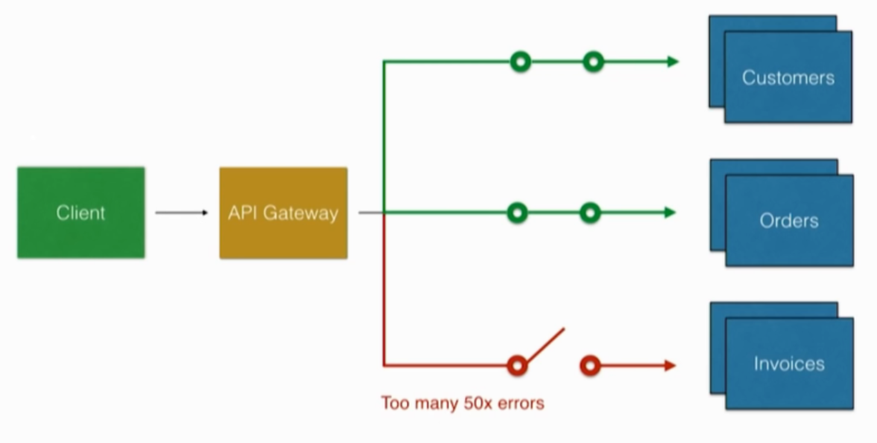
Principle 7 – Isolate Failure
Principles
Each service that consumes other services must have a strategy for handling scenarios when the other services are unresponsive, becomes very slow etc. Make sure to implement timeouts, circuit breakers and Bulkhead into your service application.
Notes:
Let’s say that one of your services suddenly stops working and returns a very high number of errors. The API gateway can implement things like circuit breakers, which means that after a specific threshold, the API gateway will stop sending data to the component that’s failing.
This gives you time to analyze the logs, implement a fix, and push an update. Usually when you have a component failing and you have lots of traffic to that component, it’s using other components and you may have a cascade failure in your infrastructure.
Circuit breakers simply close the circuit so no more requests are allowed to go to that component, and now you have time to fix and implement a solution to your problem.
Failure takes many forms:
It can be a service not responding to your service.
A connection line gone down.
A third party system failing.
When failure is found, the microservice should degrade the functionality within or use a default functionality. It shouldn’t cascade the failure. It shouldn’t crash.
Decide when you should degrade functionality and/or when you should default functionality.
Example of degrade functionality: The service can decide to not display a page
Example of default functionality: The service decide to display a default page with a message.
Make the microservice resilient by having multiple instance of microservices.
Each microservice should register themselves as they star up.
If any of these microservices fails, they will deregister themselves.
Be aware of different types of failures:
Exceptions and/or errors.
Delays in replying request.
Unavailability of a microservices.
Network failures.
Remember, we are using distributed transactions. One service may use several other services before it actually completes.
Validate microservice input from services and clients.
The microservice shouldn’t fail due wrong formatted data.

Slide 23
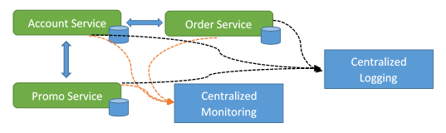
Principle 8 - Highly Observable
Principles
Our services must provide us with information so that we can see what is going on. The services should push information (log events) to us. Use appropriate tools for managing your log events. You also need to get stats from your services with tools like New Relic or Azure AppInsights you will need correlation ids to be able to understand the whole flow through a number of services.
Notes:
Current system activity.
Error currently happened.
Monitoring and logging (logs) needs to be centralized so there in one place to go in order to view information about the system health.
Centralized monitoring
Centralized Logging
Remember the system use distributed transactions across the network and several services.
System health:
Logs
Status
Information
Warnings
Errors
Need a quick way of getting feedback in response to deployment.
Data collected can be used for capacity planning and scaling up system.
Monitor business data.
Demand can be easily spotted.
Easy to make specific measurements.

Slide 24
Microservices Platforms

Slide 25




New patterns and new technologies
Platforms
Microservices
Docker Containers
Autonomous
Bounded Context
Linux Containers
Docker Image
Nomad & addressable services
Isolated
Docker Host
API Gateway
Windows Containers
Docker Registry
Decoupled
Docker Hub
Events
Async. communication
RabbitMQ
Hyper-V Containers
Event Bus
Message Brokers
Azure Service Bus
Azure Container Registry
Service Discovery
Health Checks
NServiceBus
Orchestrators
Transient Failures Handling
MassTransit
Resiliency
Brighter
Azure Service Fabric
Stateful Services
Commands
Actors
Retries with Exponential Backoff
Polly
Azure Container Service
Domain-Driven Design
Circuit Breakers
CQRS simplified
Kubernetes
Aggregates
Docker Swarm
Domain Entity
Domain Events
Mesos DC/OS
Mediator

Slide 26
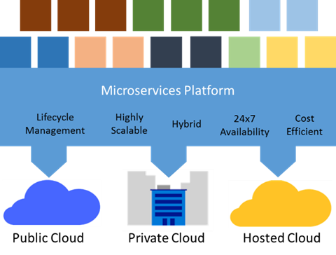
Microservices application platforms
Platforms
A full-featured microservices application platform provides all the previously stated microservices architecture benefits of cost efficiency, scalability and 24x7 availability.
It also takes these a step further.
it should choreograph safe and reliable upgrades using an extensible health model and automatic rollback.
It also helps microservices to discover each other by providing a naming service, and monitors and maintains their health.
To keep microservices healthy, the platform automatically moves instances to healthy VMs or servers when the software or hardware on which they are running fails or must be restarted for upgrades.

Slide 27
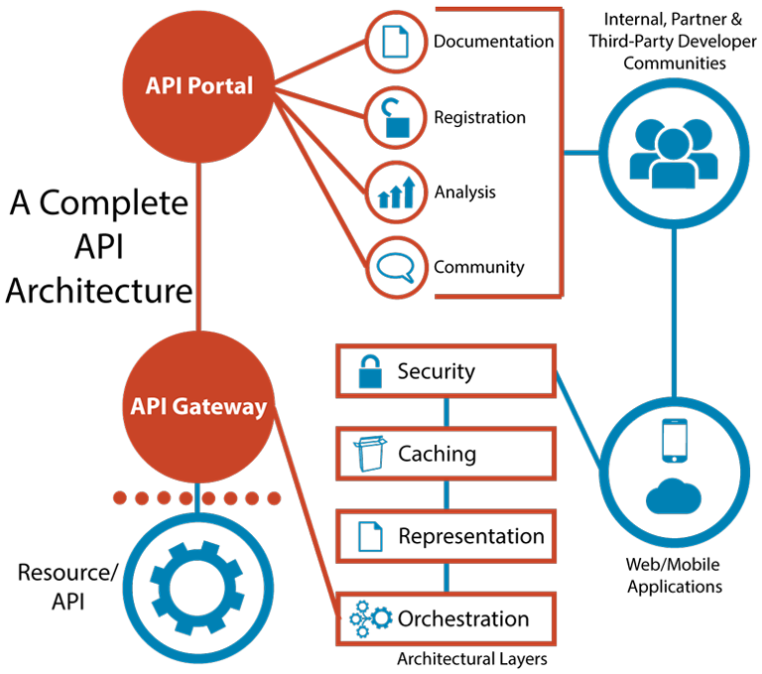
API Management
Platforms
API management provides API gateway services such as creating API proxies, configuring SSL and authentication, developer subscription key management, policy injection such as rate throttling or message transformations and performance and health analytics.
The basic concept is that you place your API under management so that direct calls are never made by clients to your API. Incoming calls first arrive at the API proxy, policies are applied, and then the call is forwarded on. When the call returns to the API proxy, it applies any outgoing policies and the output is returned to the called.
Notes:
API management provides API gateway services such as creating API proxies, configuring SSL and authentication, developer subscription key management, policy injection such as rate throttling or message transformations from JSON to XML and performance and health analytics.
The basic concept is that you place your API under management so that direct calls are never made by clients to your API. Incoming calls first arrive at the API proxy, policies are applied, and then the call is forwarded on. When the call returns to the API proxy, it applies any outgoing policies and the output is returned to the called.
A developer key must be included in the API call in order for the call to pass through to the actual API. That means that anyone who wants to invoke your API must first register on the Developer portal and request to subscribe to the API. Once they are approved, they receive a key. The developer key is the element that allows the service to gather statistics on who is calling, how often, and what performance those invocations are receiving.
Once you create an instance of API management using the Azure Portal, both an Admin Dashboard and a Developer Portal are provided. The Admin Dashboard provides the tools necessary to define API products and developer groups, and access the Analytics reports. Once a developer is registered on the Developer portal, he or she will be able to gain access to API documentation and consoles for accessing sample code, making test calls, and examining return message.

Slide 28
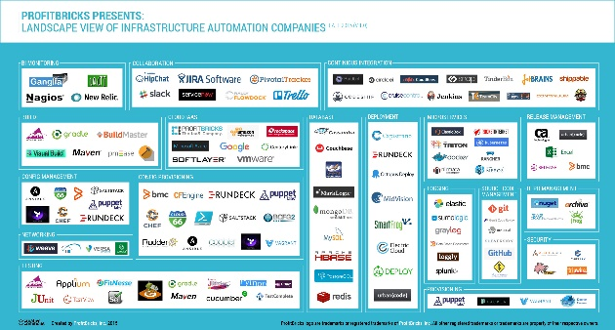
Microsoft tools and approaches
Platforms
Microservices in the wild (Docker, Kubernetes)
Azure functions
Azure Service Fabric
Implication: build your own microservices platform
Benefits: customizable, pick best-of-breed solutions
Implication: serverless microservices
Benefits: quick ramp up, sub second metering, zero ops
Implication: prescriptive microservices platform
Benefits: easy to build, deploy, and manage microservices at scale
Event-driven scale
No Ops

Slide 29
Pivotal Cloud Foundry
Platforms
Pivotal Cloud Foundry enables microservice architectures by combining workflow and container scheduling from Cloud Foundry with integrations for microservice patterns like service discovery, client side load balancing, circuit breakers and distributed tracing, utilizing Spring Cloud and NetflixOSS.
Pivotal Cloud Foundry supports ongoing microservice operations via deployment and service management capabilities such as autoscaling, blue-green updates, health monitoring, application metrics, streaming logs and more.

Slide 30


Where do Docker and container technologies come in?
Platforms
Containers
= Operating system virtualization
OS
Any OS
Container
Container
Container
Applications
Linux
Windows
Kernel
Anywhere
Hardware
On-premises
Cloud
Any app
Traditional virtual machines = hardware virtualization
Monolith
Microservice
Any language
Application
VM
VM
VM
Java
.Net
OS
Hardware
Notes:
Many people see Docker or other container technologies as enablers of a microservice architecture.
Unlike virtual machines, containers are designed to be pared down to the minimal viable pieces needed to run whatever the one thing the container is designed to do, rather than packing multiple functions into the same virtual or physical machine. The ease of development that Docker and similar tools provide help make possible rapid development and testing of services.
Of course, containers are just a tool, and microservice architecture is just a concept. So it is entirely possible to build an application which could be described as following a microservices approach without using containers, just as it would be possible to build a much more traditional application inside of a container (although this may not be a good idea)

Slide 31




The container revolution
Platforms
Standard image format for portability across environments
Virtual machine
VM-independence for efficiency, scalability, and resilience
Lightweight and agile for Cloud Native apps
Virtual machine
+
Rich ecosystem of images with tools for development and operations
Containers
Notes:
Containers are the environments in which you deploy and execute your code.
In Azure, there are several choices for deploying and executing code. Deciding which one to use is usually driven by the technology stack chosen for implementation and security configuration considerations.
If you are leverage Windows Communications Foundation (WCF) to create a SOAP or REST API or a worker role that listens on a Service Bus Queue, you will use the Azure Cloud Service container for deployment.
If you are using ASP.NET web apis, you will use Azure App Service.

Slide 32
How do you orchestrate microservices?
Platforms
In order to actually run an application based on microservices, you need to be able monitor, manage, and scale the different constituent parts. There are a number of different tools that might allow you to accomplish this.
open source tools like Kubernetes, Docker Swarm might be a part of your solution.
Another option is to use a Platform as a Service (PaaS) tool, which lets developers focus on writing code by abstracting some of the underlying orchestration technology and allowing them to easily select off-the-shelf open source components for certain parts of an application, like a database storage engine, a logging service, a continuous integration server, web server, or other pieces of the puzzle.
Some PaaS systems directly use upstream projects like Docker and Kubernetes for managing application components, while others try to re-implement management tools themselves.

Slide 33


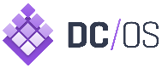
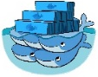

Choosing Orchestrators in Azure
Platforms
Azure Product
Orchestrator | Description | Good for | Common workloads
 | Kubernetes is an open-source platform for automating deployment, scaling, and operations of application containers across clusters of hosts | Production-ready & Windows/Linux ecosystem | Microservices based on containers
 | As a datacenter operating system, DC/OS is itself a distributed system, a cluster manager and a container platform | Production-ready & Linux ecosystem | Microservices based on containers
 | Docker Swarm is a clustering and scheduling tool for Docker containers. With Swarm, IT administrators and developers can establish and manage a cluster of Docker nodes as a single virtual system | Production-ready & Linux ecosystem | Microservices based on containers
 | Azure Service Fabric is a distributed systems platform that makes it easy to package, deploy, and manage scalable and reliable microservices | Production-ready & Linux ecosystem | Stateful svc & Actors Microservices based on plain processes Microservices based on containers
Kubernetes
Azure Container Service
Mesosphere DC/OS
Docker Swarm
Azure Service Fabric
Service Fabric
Notes:
Kubernetes
Kubernetes is an open-source system for automating deployment, operations, and scaling of containerized applications. It groups containers that make up an application into logical units for easy management and discovery. Originally developed by Google, it builds on their experiences running large scale services such as Search and Gmail.
Docker Swarm and Docker Compose
The standard packaging format and resource isolation of Docker containers have made them a natural fit with microservices architectures.
Docker Compose defines an application model that supports multiple Docker-packaged microservices, and Docker Swarm serves as a cluster manager across a set of infrastructure that exposes the same protocol that a single-node Docker installation does, so that it works with the broad Docker tooling ecosystem.
The Azure Container Service supports both Docker Swarm and Docker Compose.
Service Fabric
Service Fabric provides three broad areas to help you build applications that use a microservices approach:
A platform that provides system services to deploy, upgrade, detect, and restart failed services, discover services, route messages, manage state, and monitor health. These system services in effect enable many of the characteristics of microservices previously described.
Ability to deploy applications either running in containers or as processes. Service Fabric is a container and process orchestrator.
Productive programming APIs, to help you build applications as microservices: ASP.NET Core, Reliable Actors, and Reliable Services. You can choose any code to build your microservice. But these APIs make the job more straightforward, and they integrate with the platform at a deeper level. This way, for example, you can get health and diagnostics information, or you can take advantage of built-in high availability.
Service Fabric is agnostic on how you build your service, and you can use any technology. However, it does provide built-in programming APIs that make it easier to build microservices.

Slide 34
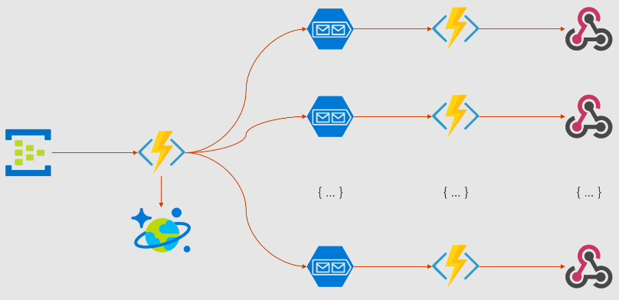
Why Serverless?
Platforms
Innovation
Reliability
Scalability
Server Abstraction
Event-Driven
Agility
Cost

Slide 35
Benefits of Serverless
Platforms
Manage apps not servers
Reduced DevOps
Faster time to market

Slide 36








Serverless application platform components
Platforms
Development
Platform
IDE support
Functions
Logic Apps
Event Grid
Execute your code based on events you specify
Design workflows and orchestrate processes
Manage all events that can trigger code or logic
Integrated DevOps
Local Development
Monitoring
Database
Storage
Security
IoT
Analytics
Intelligence
Visual Debug History
Visual Debug History

Slide 37
Security

Slide 38
Security Benefits of Microservices and API Gateways
Security
Faster Distribution of important security patches
Because most organizations marry a DevOps frequent-release cycle with the move to microservices, instead of releases occurring once or twice a year, they can happen once or twice a week—or multiple times a day. That means important security updates can start protecting systems much, much faster than in the past.
Smaller attack surfaces
A key element of microservices is that each service provides a restricted set of functionality (a bounded context). Some people characterize it as a “do one thing and do it well,” UNIX-like approach. Consequently, each service exposes a well-restricted interface. After all, if the service does only one thing, the only interface required is what’s needed to support that one thing. The net effect of this is that each service has a smaller attack surface: the sum of the points at which a piece of software may be attacked.
Prevents exposing internal concerns to external clients. An API gateway separates external public APIs From internal microservice APIs, allowing for microservices to be added and boundaries changed. The result is the ability to refactor and right-size microservices over time, without negatively impacting externally-bound clients. It also hides service discovery and versioning details from the client by providing a single point of entry for all of your microservices.
Adds an additional layer of security to your microservices. API gateways help to prevent malicious attacks by providing an additional layer of protection from attack vectors such as SQL Injection, XML Parser exploits, and denial-of-service (DoS) attacks.
Microservices simplifies security monitoring because the various parts of an app are isolated. A security problem could happen in one section without affecting other areas of the project

Slide 39
DevOps

Slide 40


Microservices and DevOps: Better together
DevOps
Code
Build & Integrate
Testing
The lifecycle of a microservice should be fully automated, from design all the way through deployment.
Cloud simplifies the adoption of DevOps practices
Feedback
Monitoring
Distribution

Slide 41
Need More slides/info on Devops. See what can be used from the Accenture DevOps pilot

Slide 42
Design Patterns
Don’t re-invent the wheel, solutions to your challenges have already been identified.

Slide 43
Design Patterns
Key Patterns for Microservices
Direct communication vs. API Gateway
Health checks
Resilient cloud applications:
Retries with exponential backoff plus Circuit breaker
Async. pub/subs communication (Event Bus)
Scale-out with Orchestrators

Slide 44
Design Patterns
Health Checks API
Microservice 1
/health
HealthChecks
WatchDog app
Microservice 2
/health

Slide 45
Design Patterns
Health Checks API
Usually
Provided by the Orchestrator
(i.e. Service Fabric, Kubernetes, etc.)
API Gateway
Microservice 1
Consumer A
Router
/health
Microservice 2
Consumer B
query
/health
Service Registry

Slide 46



Design Patterns
Building resilient cloud applications
Client Mobile App
Back end
With
Retries w/ exponential backoff & Circuit-Breakers
Microservice 1
JSON
Web API
Container
Client SPA WebApp
API Gateway
Microservice 2
ASP.NET Core
Web API
Web API
JSON
HTTP
Container
Container
Request/Response
JavaScript / Angular.js
HTTP
Request/Response
Microservice 3
Web API
Traditional WebApp
Browser
Client WebApp MVC
Container
Implement resilient communication
HTML
ASP.NET Core MVC
Container
Implement resilient communication
HTML

Slide 47
Design Patterns
Retries with Exponential Backoff
Back end
Retry 3
Success!
Microservice 1
Web API
Retry 2
Retry 1
API Gateway
Microservice 2
ASP.NET Core
Web API
HTTP
Web API
HTTP
Request/Response
Microservice 3
Web API
Client WebApp MVC
ASP.NET Core MVC
Container

Slide 48
Design Patterns
Retries with Exponential Backoff
+ Circuit Breaker
Back end
Retry 4!
Open Circuit!
Microservice 1
Retry 3
Web API
Retry 2
Retry 1
API Gateway
Microservice 2
ASP.NET Core
Web API
HTTP
Web API
HTTP
Request/Response
Respond with
Exception
Microservice 3
Web API
Client WebApp MVC
ASP.NET Core MVC
Container

Slide 49
Design Patterns
Risk of Partial Failure Amplified by Microservices
HTTP request/response communication
Backend / Orchestrator
Multiple
Customers
Dependency
1
Dependency
2
Browser
Web App
Dependency
6
Multiple
HTTP requests
Dependency
3
Dependency
5
Submit Order page
Dependency
7
Dependency
4
Dependency
8
Anti-patterns

Slide 50
Design Patterns
How to minimize exponential failures in microservices
Circuit-Breakers
Avoid long Http call chains within the same request/response cycle

Slide 51
Design Patterns
Synchronous vs. Async communication across Microservices
Anti-pattern
Synchronous
all req./resp. cycle
Client
Http sync.
request
Http sync.
request
Http sync.
request
Http sync.
request
Basket
Ordering
Catalog
Other
Http sync.
response
Http sync.
response
Http sync.
response
Http sync.
response
i.e. MVC app,
API Gateway, etc.
Same Http Request/Response cycle!
Asynchronous
Comm. across internal microservices
(EventBus: i.e. AMPQ)
Http sync.
request
Client
Basket
Ordering
Catalog
Other
Http sync.
response
i.e. MVC app,
API Gateway, etc.
“Asynchronous”
Comm. across internal microservices
(Polling: Http)
Client
Http sync.
request
Http
Polling
Http
Polling
Http
Polling
Basket
Ordering
Catalog
Other
Http sync.
response
i.e. MVC app,
API Gateway, etc.
Http
Polling

Slide 52
Design Patterns
Asynchronous Event-Driven communication with an Event Bus
Backend
Basket Microservice
Database as
Cache
User-Profile Microservice
Service
1
Web API Service
3
UserUpdated event → Buyer info
UpdateUser
command
Event Bus
(Publish/Subscribe Channel)
4
UserUpdated event
(Publish Action)
2
UserUpdated event → Buyer info
DB update
Event Bus Abstractions/Interface
Ordering Microservice
Database
Event Bus Implementations
Azure
Service
Bus
Other:
NServiceBus
MassTransit
etc.
Database
RabbitMQ
Service
Eventual consistency across microservices’ data based on event-driven async communication

Slide 53
Domain Driven Design Aggregates and Bounded Context for Decomposition of Microservices
Design Patterns
When you’re moving to Microservices architecture from a monolithic architecture, the big question is how to decompose the Microservices. How to break up a larger software system into functional components?. What’s the size of a Microservice? The answer is very simple: domain modelling.
Aggregates and Bounded Contexts are the building block to build your Microservices, which will decide the size of a single Microservice.
Typically business entities like Order, Customer, Account are Aggregates, which represent a graph consisting of a root entity and one or more other entities and value objects, and can be treated as a unit.
A better way to perform a transaction in Microservices is to perform persistence against aggregates.
Bounded Context is a central pattern in Domain-Driven Design, which provides logical separation of business problem into various sub domains by dividing a large model into different Bounded Contexts.
A Bounded Context encapsulates the details of a single domain, a sub domain of large domain model, which can be partitioned into a single Microservices.
A common strategy for building Microservices is to build it against each Bounded Context.
Each Microservice uses its own database to persist data of domain model of a Bounded Context.
Aggregates and Bounded Contexts are important concepts in Microservices architecture, which are the foundational block to build your Microservices, which will also decide the size of your Microservices. In short, Microservices are autonomous services around Bounded Context.
Notes:
DDD, introduced various building blocks such as Entity, Value Object, Services, Repositories, Aggregates and Bounded Context.
A single Bounded Context can
include many aggregate roots, or we can organise a single aggregate root into a single Bounded Context.
An Order aggregate root, consists of entities such as OrderLine, Customer and Product, and value objects such as ShippingAdress, PaymentMethod etc.
Within the graph of Order aggregate root, Customerentity can also be treated as a aggregate root because it can organise as a root entity for getting all information for a customer.

Slide 54
Building Scalable Microservices with Event Sourcing (Event Driven Architecture)
Design Patterns
DDD Aggregates and Bounded Contexts are the foundational building blocks of Microservices, but when you’re going to choose a concrete architecture for building your distributed system to solve practical challenges of Microservices, an event-driven reactive system on DDD aggregates would be a great approach.
Event Sourcing deals with an event store of immutable log of events, in which each log (a state change made to an object) represents an application state. Because every state change in the application, is treated as an immutable log, you can easily troubleshoot the application and can also going back to a particular version of application state at any time.
An event store is like a version control system. In a Microservices architecture, we can persist aggregates as a sequence of event. Events are facts, which represent some actions happened in the system.
These are immutable, which can’t be changed or be retracted. If you would like to make a change in the system, do persist logs into the event store to represent an another set of events.
The example of events are OrderCreated, OrderApproved, OrderShipped, OrderDelivered, etc.
An event-driven, reactive architecture is a great choice of architecture approach for building massively scalable Microservices.
Notes:
In your Event Driven architecture, when you publish one event from one Microservice, other Microservices can be reactive to those events and publish another set of events.
A single transaction in a Microservices system may span into multiple Microservices where we can perform a transaction as a sequence of events by building reactive Microservices.
Each state change of an aggregate can be treated as an event, which is an immutable fact about your system.
In order to publish events to let other Microservices know about something has happened in our system, we can use messaging systems like RabbitMQ, etc.

Slide 55
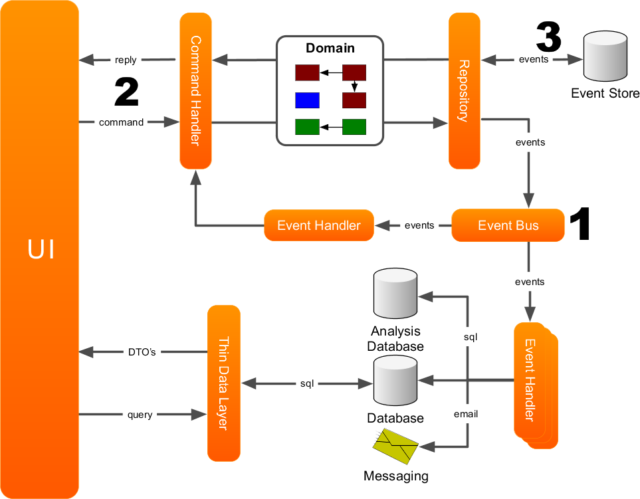
Command Query Responsibility Segregation (CQRS)
Design Patterns
When you make persistence as a sequence of events by using an Event Sourcing, you may need an architecture approach to make queries for your Microservices.
Command Query Responsibility Segregation (CQRS) is an ideal pattern for implementing queries for your Microservices.
Commands to perform an action to change the state of aggregates, and
Queries to provide a query model for the views of aggregates.
We may also use different databases for both write operations and query operations. This will also allows you to make a high performing query model by loading de-normalised data sets into data stores of read models. NoSQL/NewSQL databases are great options to store the data of read models.
Notes:
Although Event Sourcing and CQRS, are great patterns for implementing a distributed system using Microservices architecture, it’s not a silver bullet and it has its own limitations. You may need different architecture style for building some kind of Microservices systems. But generally, I feel that Event Sourcing, paired with CQRS, is a great approach for implementing Microservices systems.

Slide 56
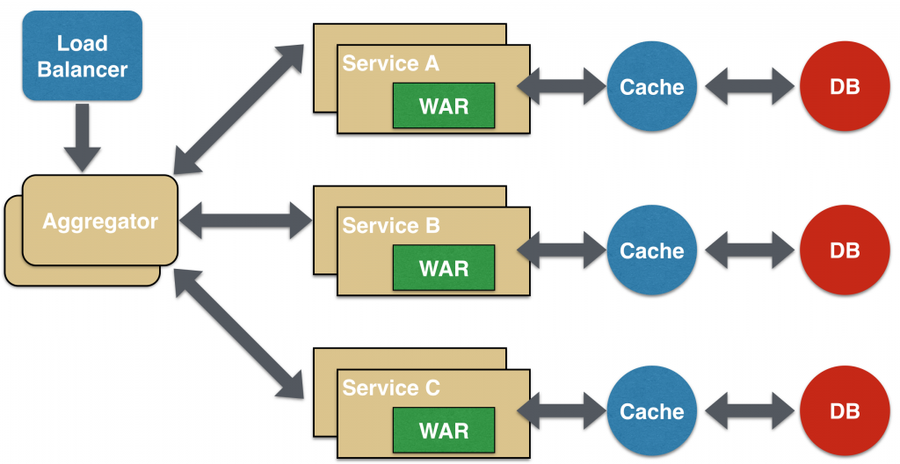
Aggregator Microservices Design Pattern
Design Patterns
In its simplest form, Aggregator would be a simple web page that invokes multiple services to achieve the functionality required by the application. Since each service (Service A, Service B, and Service C) is exposed using a lightweight REST mechanism, the web page can retrieve the data and process/display it accordingly. If some sort of processing is required, say applying business logic to the data received from individual services, then you may likely have a CDI bean that would transform the data so that it can be displayed by the web page.
Another option for Aggregator is where no display is required, and instead it is just a higher level composite microservice which can be consumed by other services.
The aggregator would just collect the data from each of the individual microservice, apply business logic to it, and further publish it as a REST endpoint. This can then be consumed by other services that need it.
This design pattern follows the DRY principle. If there are multiple services that need to access Service A, B, and C, then its recommended to abstract that logic into a composite microservice and aggregate that logic into one service. An advantage of abstracting at this level is that the individual services, i.e. Service A, B, and C, and can evolve independently and the business need is still provided by the composite microservice.

Slide 57
Migrating Existing Solutions to Microservices

Slide 58


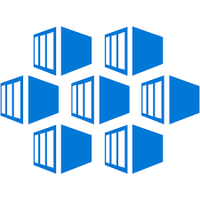
















Migration
Existing .NET Application Modernization: Maturity Models
Existing Apps
.NET Web apps (on-prem.)
Cloud
Infrastructure-Ready
Cloud
DevOps-Ready
Cloud-Optimized & Cloud-Native
Full PaaS and Cloud-Native
Monolithic Architecture
Monolithic Architecture
Monolithic Architecture
Microservices and Monolithic Architectures
Relational Database
IaaS
+ Managed Services
PaaS + Managed Services
On-Premises
Azure
Azure
Azure
LIFT & SHIFT: No re-architect, no code changes
Architected for the cloud (Needs new code)
Notes:
Microservices architecture is not required for most of the use cases, and a middle-grounded solution is better approach to engineering most of the applications.
You can adopt a hybrid approach to solve your problems.
An architecture approach should solve your problem and use it for solving your own unique problems instead adopting something for the sake of that.
You can improve your existing monolithic applications in different ways:
splitting your monolithic application into multiple systems without blindly following the Microservices guidelines, but with a hybrid architecture approach and with a DevOps culture and a modern CI/CD pipeline.
The great benefit of Microservices is modularization. When you build new applications, you can architect systems by applying modular system design principles without a Microservices architecture in front of you.
This approach will also enable you easier migration to Microservices if you would like to move to Microservices later on for scaling modules and teams independently. You don’t need to start a new application with Microservices.
It is better to start as a monolith application by applying modular system design principles, and when your system and teams are evolving, you can move to Microservices if it is really essential.

Slide 59
Microservices are Evolutionary
Migration
One of the benefits of microservice architecture is that you can evolve towards this approach one service at a time
Over time, more and more capabilities can be migrated, shrinking the scope of the monolith until it is just a husk of its original form.
The move to microservices will open the door to new user experiences and new business opportunities.
Recommendations
Decide on the problems you are solving
You can and probably will have mixture of traditional and Microservices, and that is okay
Decided on a narrow, well define area to re-architect
Containers can be a good first step to reuse code
Add new services for area needing agility and scale

Slide 60
Start small
Migration
Form a small cross-functional team
Provide training and guidance on adopting Agile, Scrum, Azure and microservice architecture
Provide a separate physical location for this team to work so that they are not adversely effected by internal politics and old habits.
Take a minimal viable product approach and begin to deliver small incremental releases of one microservice, taking the process all the way through the Lifecyle.
Integrate this service with the existing systems using a loosely coupled approach.
Go through the lifecycle on this microservice several times until you feel comfortable with this process.
Put the core team into leadership positions as you form new cross-functional teams disseminate the knowledge.

Slide 61
Where do we start?
How to start creating value now?

Slide 62
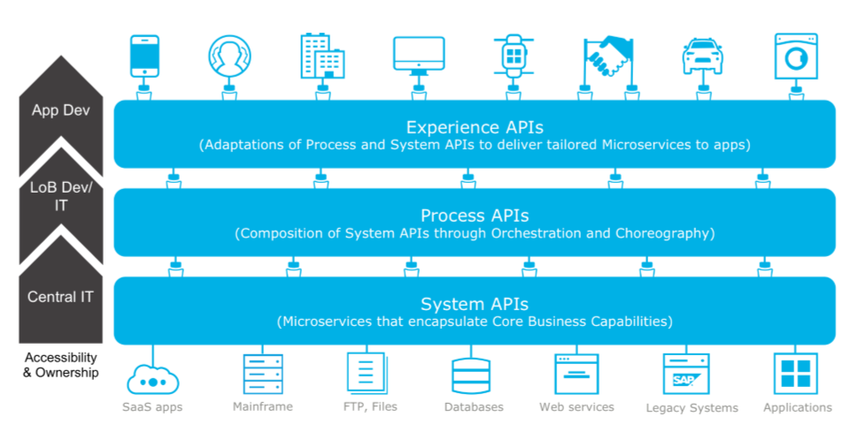
API-led Connectivity to Deliver Business Capabilities
How to Start
Dow should strive to deliver these capabilities through API invocation and domain event subscription and which can deliver value to the business in multiple contexts

Slide 63
SLIDES on Data as Service

Slide 64
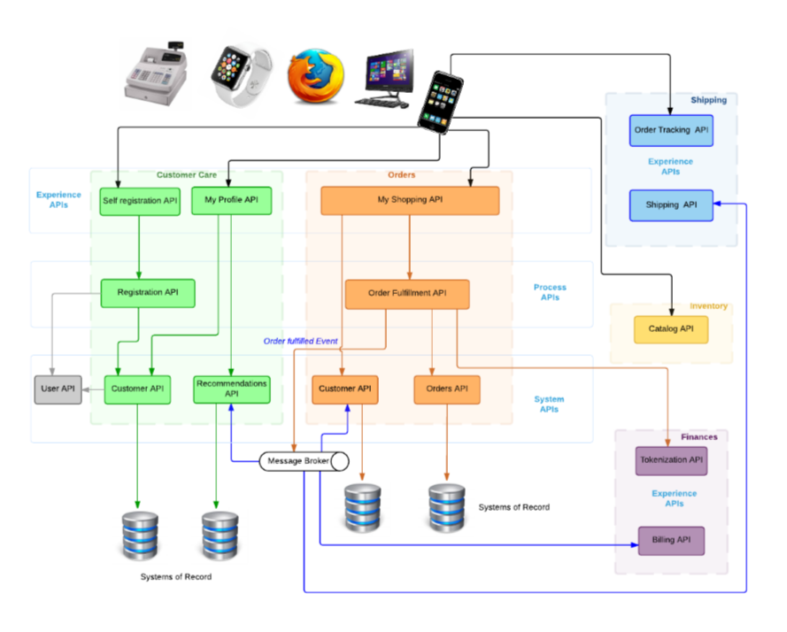
Example Microservices Designed for a Specific Business Domain
How to Start

Slide 65
Summary

Slide 66
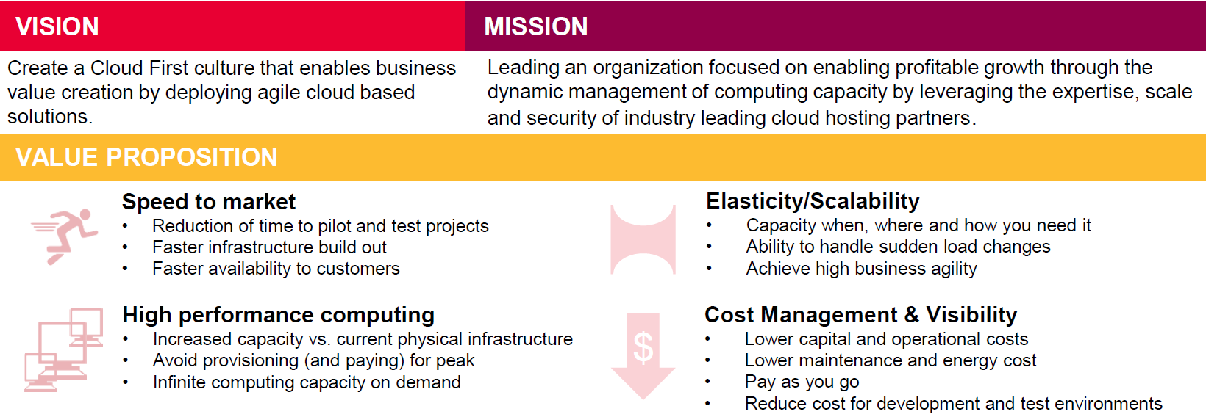
To Create a Cloud First culture that enables business value creation by deploying agile cloud based solutions….
Summary

Slide 67
Will Require a Microservices Approach that is…
Summary
Resilient/Flexible – failure in one service does not impact other services. If you have monolithic or bulky service errors in one service/module it can impact other modules/functionality.
High scalability – demanding services can be deployed in multiple servers to enhance performance and keep away from other services so that they don’t impact other services. Will be difficult to achieve same with single, large monolithic service.
Easy to enhance – less dependency and easy to change and test
Low impact on other services – being an independent service, this has less chance to impact other services
Easy to understand since they represent the small piece of functionality
Freedom to choose technology – allows you to choose technology that is best suited for a particular functionality
Benefits from DevOps – can more easily support devops principles around CI, CD, etc
Security - Microservices simplify security monitoring because the various parts of an app are isolated. A security problem could happen in one section without affecting other areas of the project.
Increase the autonomy of individual development teams within an organization, as ideas can be implemented and deployed without having to coordinate with a wider IT delivery function.

Slide 68
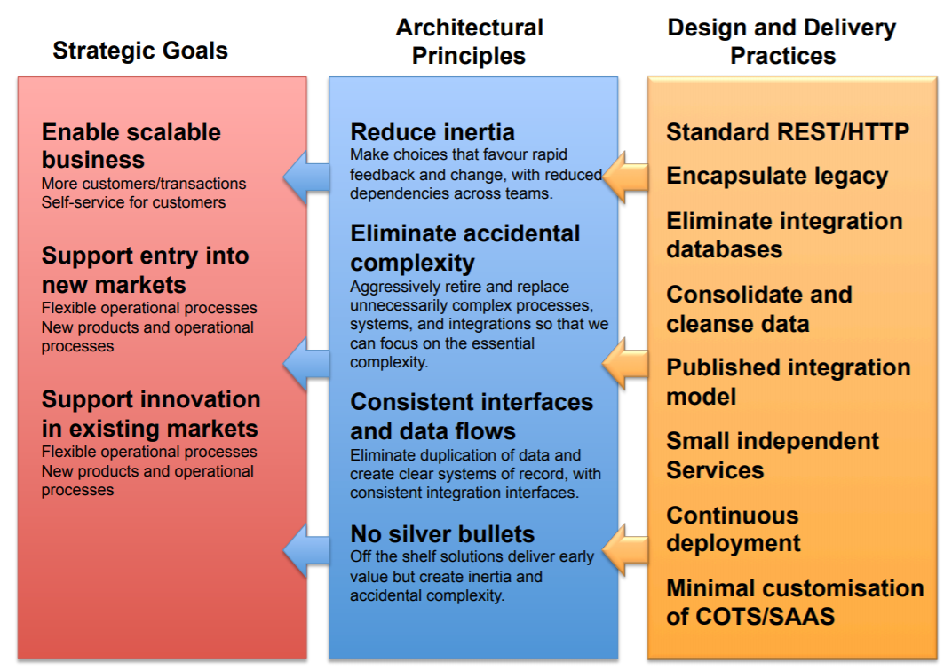
That complements Business Agility with Technical Agility and…

Slide 69
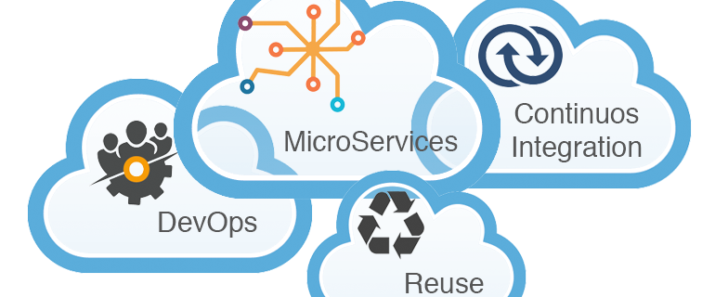
… built on new Modern Software Development Capabilities in the Cloud
Summary
For DOW and the Chicago DMC to reap benefits of the cloud we need to shift our thinking on how we design applications to be CLOUD-NATIVE
A cloud-native approach to the software delivery lifecycle enables us to effectively operate and scale, achieving “agility” - the ability to quickly add new functionality to our software while remaining stable and secure in production.

Slide 71
Appendix

Slide 72
Reading List
Martin Fowler Blog
https://martinfowler.com/microservices/
Book recommendation -
Building Microservices: Designing Fine-Grained Systems (by Sam Newman)
https://www.amazon.com/Building-Microservices-Designing-Fine-Grained-Systems/dp/1491950358/ref=sr_1_1?ie=UTF8&qid=1507822426&sr=8-1&keywords=building+microservices

